Slide 1


CMR ENGINEERING COLLEGE
(UGC AUTONOMOUS)
(Accredited by NBA,Approved by AICTE NEW DELHI, Affiliated to JNTU, Hyderabad)
Kandlakoya, Medchal Road, Hyderabad-501 401.
Department of Computer Science & Engineering
Major Project
On
Indian Currency Classification and Fake Note Identification using
Feature Ensemble Approach
Internal Guide:-
Dr. B. Kishor ,
Associate Professor,
Dept. of CSE.
By
K. Priyanka
J. Bishwas Reddy
K. Bala krishna
P. Saikiran Mourya
: (208R1A05F1)
: (208R1A05E3)
: (208R1A05E4)
: (208R1A05G3)
A.Y:- 2023-2024

Slide 2
TABLE OF CONTENT
Abstract
Introduction
Literature survey
Existing System
Proposed System
Software Requirement
Hardware Requirements
System Design
Conclusion
References

Slide 3
ABSTRACT
People with cognitive problems face a lot of difficulty in currency recognition and counterfeit notes identification. The change of currency notes during different time frames also adds more difficulty in identifying features in currency notes manually by the visually challenged. Further, the number of counterfeit notes continues to increase in India is every year. Computer-aided currency recognition and fake note detection can help people by classifying currency denomination without any dependency on the manual process. Through this work, we have proposed a currency recognition algorithm that can classify an Indian currency and be able to help in identifying the fake notes without manual intervention and by preventing their circulation in the country. Through this work, “Chan Vese Segmentation” is used to segment the security features of a note and then an ensemble of classifiers is used for classification and fake note identification. Experimental results demonstrate promising results even on the small dataset. The method can be extended to currency recognition for various countries.

Slide 4
INTRODUCTION
.
Along with classifying the notes, identifying the counterfeit ones is also an important task because this is one of the reasons due to which the Indian Government has banned 500,1000 notes overnight. Further, the government has declared many new security features of the new 2000, 500 notes, copying and making the counterfeit notes out of the new 2000, 500 notes is a perplexing task but the government's data shows that overcoming these security features is not a difficult task after all . Reports of the National Crime Records Bureau (NCRB) disclose that 2000Rs currency notes constitute 56% of all fake currency seized in India in the years 2017,2018 while the new 500 notes constitute only 4% of fake currency in these years. Due to this, the RBI stopped production of 2000 notes.
The main reason for these notes circulating in the public in vast amounts is not only due to people who make fake notes but also due to lack of awareness of security features. The general public cannot differentiate between fake and original notes, especially the visually challenged ones.

Slide 5
LITERATURE REVIEW
B. Sharma and A. Kaur, "Recognition of Indian paper currency based on lbp", International Journal of Computer Applications, vol. 59, no. 1, 2012.
K. Verma, B. K. Singh and A. Agarwal, "Indian currency recognition based on texture analysis", 2011 Niram University International Conference on Engineering, pp. 1-5, 2011.
M. Gogoi, S. E. Ali and S. Mukherjee, "Automatic indian currency denomination recognition system based on artificial neural network", 2015 2nd International Conference on Signal Processing and Integrated Networks (SPIN), pp. 553-558, 2015.

Slide 6
EXISTING SYSTEM
Throughout the years many works have using different machine learning techniques to classify currency images.
Sharma has used local binary pattern(LBP) to extract the features from the note. In LBP, the neighbourhood pixels are generated to binary code 0 or 1 . For the feature extraction part, the first method is to convert the image into a Gray scale image then the LBP values for each pixel is calculated which gives the resulting LBP image.
Gogoi He have proposed a pipeline where initially the image is pre-processed to enhance some features, reduce the size of the image and remove noise, then dominant colour (DC) of the note is found, then aspect ratio using dimensions, after that portion of the image containing ID is segmented. He trained Artificial Neural Network is used to classify the shape of IMD. Based on 3 features (IMD., Aspect ratio (AR), Dominant Colour ) the identification is done. And used 50 images of each currency (20,50,100,500,1000).

Slide 7
DISADVANTAGES
The main drawback of all these existing methods is that they cannot recognize a fake note. Further, a currency note is a collection of several security features but consider only the identification mark, denomination of the note throwing all other important security features. Also, the use CNNs which are computationally expensive hence it takes more time for a prediction.

Slide 8
PROPOSED SYSTEM
In the proposed work we have used multiple security features for the classification of currency notes we propose a method to identification of the currency notes using some of the robust machine learning techniques. The proposed method can identify fake notes. The main 4 stages of the pipeline are, Chan Vese segmentation, Extraction of different features from Region of Interest(ROI), passing the extracted features to different classifier individually.
The prediction using an ensemble of classifiers, fake note identification and All the classifiers must predict the same class for a given sample otherwise the note is declared fake.
We explore various previous works on Indian currency recognition. we demonstrated the proposed method by the dataset used and experimental results, we conclude the article with future directions.

Slide 9
ADVANTAGES OF PROPOSED SYSTEMS
1.Multi-Security Features: One of the key advantages is that the proposed system utilizes multiple security features for the of currency notes.
2. Ensemble of Classifiers: The use of an ensemble of classifiers is a robust approach. By requiring a consensus among multiple classifiers to predict the authenticity of a currency note, the system becomes more resilient to individual errors or noise in the data. This can result in more reliable detection of counterfeit notes.
3. The proposed system follows a structured pipeline approach with well-defined stages, including segmentation, feature extraction, individual classification, and ensemble-based decision-making. This clear pipeline can make it easier to understand and replicate the process.

Slide 10
SYSTEM REQUIREMENTS
H/W System Configuration:-
Processor - Intel i5-11^{th GEN}
RAM - 4 GB (min)
Hard Disk - 500 GB

Slide 11
SOFTWARE REQUIREMENTS
Operating system : Windows 10 or 11.
Coding Language : Python.
Front-End : HTML, CSS, JavaScript.
Back-End : Django
Data Base :MYSQL

Slide 12
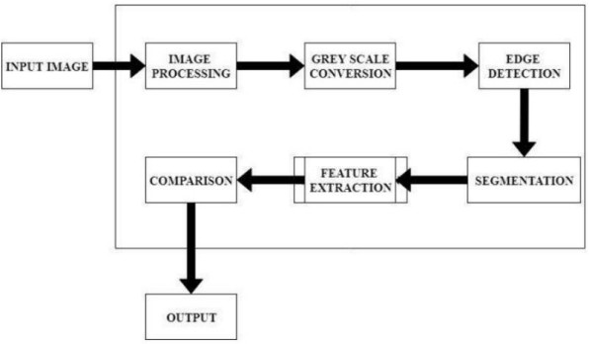
SYSTEM DESIGN

Slide 13
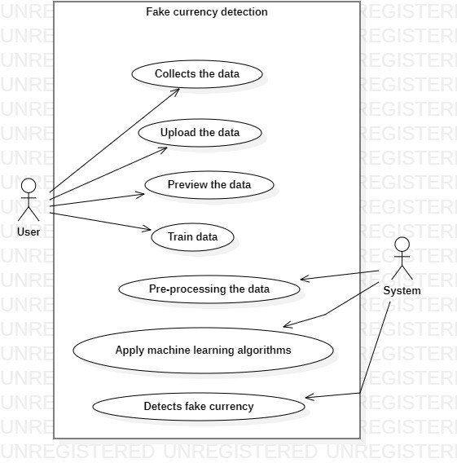
USE CASE DIAGRAM:

Slide 14
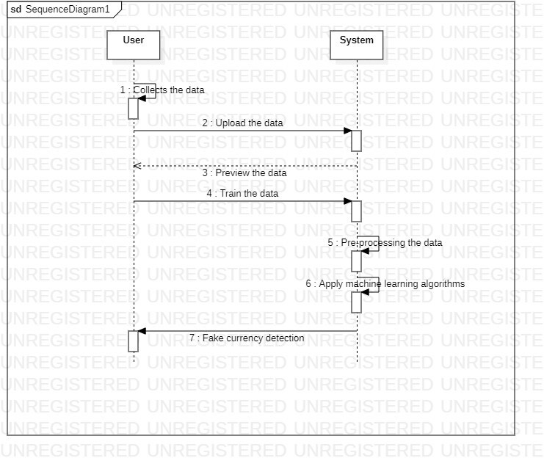
SEQUENCE DIAGRAM:

Slide 15
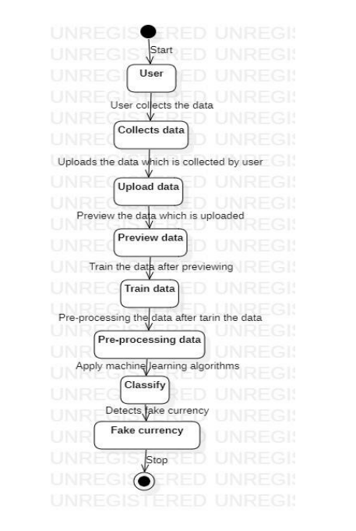
ACTIVITY DIAGRAM

Slide 16
CONCLUSION
In this work, we have discussed that how our proposed system detects the fake bank currency using machine learning algorithms. The proposed system is also scalable for detecting the whether the currency is fake or not by image processing. The system is not having complex process to detect the whether the data contains fake bank currency like the existing system. Proposed system gives genuine and fast result than existing system. Here in this system we use cnn algorithm to detect whether currency is fake or not.

Slide 17
Modules
Data Collection
Pre-Processing
Feature Extraction
Detect Fake Currency

Slide 18
REFERENCES
B. Sharma and A. Kaur, "Recognition of Indian paper currency based on lbp", International Journal of Computer Applications, vol. 59, no. 1, 2012.
K. Verma, B. K. Singh and A. Agarwal, "Indian currency recognition based on texture analysis", 2011 Niram University International Conference on Engineering, pp. 1-5, 2011.
M. Gogoi, S. E. Ali and S. Mukherjee, "Automatic indian currency denomination recognition system based on artificial neural network", 2015 2nd International Conference on Signal Processing and Integrated Networks (SPIN), pp. 553-558, 2015.
B. Sharma and A. Kaur, "Recognition of Indian paper currency based on lbp", International Journal of Computer Applications, vol. 59, no. 1, 2012.

Slide 19
Implementation

Slide 20
Modules

Slide 21
Libraries

Slide 22
Algorithms

Slide 23
Test cases

Slide 24
ER diagrams

Slide 25


